Slide 1
Server-Side Programming & Node.js Intro

Slide 2
Front end and Back end
Front end / Client-side
HTML, CSS and Javascript
Asynchronous request handling and AJAX
Back end / Server-side
Node.js, PHP, Python, Ruby, Perl
Compiled languages like C#, Java or Go
Various technologies and approaches
https://en.wikipedia.org/wiki/Front_and_back_ends

Slide 3
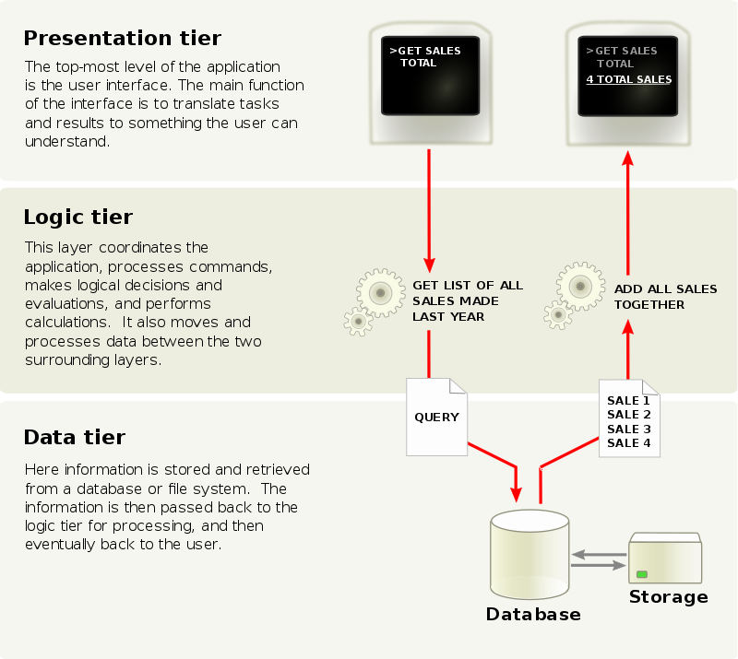
N-tier Architecture
Presentation Layer
Concerned with UI related issues
Business Logic Layer
Data validation, dynamic content processing
Full stack
Data Access Layer
Data persistence, data access through an API
https://en.wikipedia.org/wiki/Multitier_architecture#Three-tier_architecture

Slide 4









Traditional Web Development
HTML, CSS, JS
Ruby, Python, Java, C++, PHP
DBMS
Server-side
rendering
Presentation layer
Business Logic layer
Data Access layer

Slide 5


Full Stack JavaScript Development
Single page Apps
using JavaScript frameworks/libraries
like Angular or React
NodeJS and
NodeJS modules
MongoDB
JSON documents
REST API
serving JSON
Presentation layer
Business Logic layer
Data Access layer

Slide 6
Full Stack Web Development
UI Framework Bootstrap 4 / Angular Material
JS Framework/library Angular/React
BaaS
NodeJS Modules
JS
CS S
HT
NodeJS
MongoDB
ML
Presentation layer
Business Logic layer
Data Access layer
Presentation layer

Slide 7
Node.js Intro

Slide 8
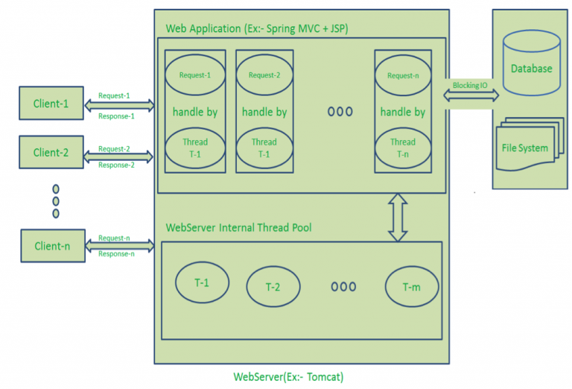
Traditional Web Application Processing Model
Multi-Threaded Request-Response
If “n” is greater than “m” (Most of the times, its true), then server assigns Threads to Client Requests up to available Threads. After all m Threads are utilized, then remaining Client’s Request should wait in the Queue until some of the busy Threads finish their Request-Processing Job and free to pick up next Request.
If those threads are busy with Blocking IO Tasks (For example, interacting with Database, file system, JMS Queue, external services etc.) for longer time, then remaining clients should wait longer time.
https://www.journaldev.com/7462/node-js-architecture-single-threaded-event-loop
Notes:
https://www.journaldev.com/7462/node-js-architecture-single-threaded-event-loop

Slide 9
Drawbacks of Request/Response Stateless Model
Handling more and more concurrent client’s request is bit tough.
When Concurrent client requests increases, then it should use more and more threads, finally they eat up more memory.
Sometimes, Client’s Request should wait for available threads to process their requests.
Wastes time in processing Blocking IO Tasks.

Slide 10
I/O
I/O: A communication between CPU and any other process external to the CPU (memory, disk, network).
I/O latency is defined simply as the time that it takes to complete a single I/O operation.
System Event | Actual Latency | Scaled Latency
One CPU cycle | 0.4 ns | 1 s
Level 1 cache access | 0.9 ns | 2 s
Level 2 cache access | 2.8 ns | 7 s
Level 3 cache access | 28 ns | 1 min
Main memory access (DDR DIMM) | ~100 ns | 4 min
Intel® Optane™ DC persistent memory access | ~350 ns | 15 min
Intel® Optane™ DC SSD I/O | <10 μs | 7 hrs
NVMe SSD I/O | ~25 μs | 17 hrs
SSD I/O | 50–150 μs | 1.5–4 days
Rotational disk I/O | 1–10 ms | 1–9 months
Internet call: San Francisco to New York City | 65 ms[3] | 5 years
Internet call: San Francisco to Hong Kong | 141 ms[3] | 11 years
https://www.prowesscorp.com/computer-latency-at-a-human-scale/

Slide 11
I/O needs to be done differently
Consider two scenarios in real word:
Movie Ticket
You are in a queue to get a movie ticket. You cannot get one until everybody in front of you gets one, and the same applies to the people queued behind you.
Order Food
You are in a restaurant with many other people. You order your food. Other people can also order their food, they don't have to wait for your food to be cooked and served to you before they can order. In the kitchen restaurant workers are continuously cooking, serving, and taking orders. People will get their food served as soon as it is cooked.
Synchronously
Asynchronously

Slide 12
Blocking vs non-blocking?
const add = (a,b)=>{
for(let i=0; i<9e27; i++){}
console.log(a+b);
}
console.log('start');
const A = add(1,2);
const B = add(2,3);
const C = add(3,4);
console.log('end');
const add = (a,b)=>{
setTimeout(()=>{
for(let i=0; i<9e27; i++){}
console.log(a+b);
}, 5000);
}
console.log('start');
const A = add(1,2);
const B = add(2,3);
const C = add(3,4);
console.log('end');
Blocking methods execute synchronously
non-blocking methods execute asynchronously
Notes:
https://nodejs.org/en/docs/guides/blocking-vs-non-blocking/

Slide 13
Why JavaScript?
JavaScript designed specifically to be used with an event loop:
Anonymous functions, closures.
Only one callback at a time, no need to lock variables.
I/O through event callbacks.
The culture of JavaScript is already geared towards event-driven programming.
puts("Enter your name: ");
var name = gets();
puts("Name: " + name);
We’re taught to demand input and do nothing until we have it.
puts("Enter your name: ");
gets(function (name) {
puts("Name: " + name);
});
Code like this is rejected as too complicated.
Notes:
Javascript is always a synchronous(blocking) single thread language but we can make Javascript act Asynchronous through programming.

Slide 14



Review: Chrome – Concurrency & the Event Loop
Web APIs
Heap Stack
SetTimeOut (callback2)
AJAX (callback1)
Reduce()
Filter()
Add()
Main()
Callback/Task Queue
Push only
When Stack
Is Empty
callback1
Callback 2
onClick callback
Event
Loop
One thing at a time? Not really!
If you block the stack, browser can’t do the render queue
14

Slide 15
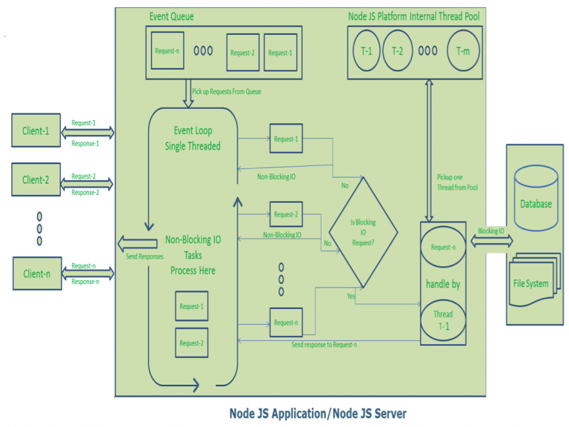
Node JS Architecture – Single Threaded Event Loop
Node JS Processing model mainly based on Javascript Event based model with Javascript callback mechanism.
Node JS Event Loop Picks up those requests one by one.
Event Loop pickups Client-1 Request-1
Checks whether Client-1 Request-1 does require any Blocking IO Operations or takes more time for complex computation tasks.
As this request is simple computation and Non-Blocking IO task, it does not require separate Thread to process it.
Event Loop process all steps provided in that Client-1 Request-1 Operation (Here Operations means Java Script’s functions) and prepares Response-1
Event Loop sends Response-1 to Client-1
…
Event Loop pickups Client-n Request-n
Checks whether Client-n Request-n does require any Blocking IO Operations or takes more time for complex computation tasks.
As this request is very complex computation or Blocking IO task, Even Loop does not process this request.
Event Loop picks up Thread T-1 from Internal Thread pool and assigns this Client-n Request-n to Thread T-1
Thread T-1 reads and process Request-n, perform necessary Blocking IO or Computation task, and finally prepares Response-n
Thread T-1 sends this Response-n to Event Loop
Event Loop in turn, sends this Response-n to Client-n
Notes:
https://www.journaldev.com/7462/node-js-architecture-single-threaded-event-loop
Node JS Web Server receives those requests and places them into a Queue. It is known as “Event Queue”.

Slide 16
Node JS Architecture - Single Threaded Event Loop Advantages
Handling more and more concurrent client’s request is very easy.
Even though our Node JS Application receives more and more Concurrent client requests, there is no need of creating more and more threads, because of Event loop.
Node JS application uses less Threads so that it can utilize only less resources or memory
Notes:
If that Client Request Does Not requires any Blocking IO Operations, then process everything, prepare response and send it back to client. If those computations takes very long time, it’s better to use multi-thread

Slide 17
Node.js
JavaScript runtime built on Chrome V8 JavaScript Engine
Server-side JavaScript
Allows script programs do I/O in JavaScript
Event-driven, non-blocking I/O
Single Threaded
CommonJS module system
Focused on Performance

Slide 18
Setting up Node.js
Go to nodejs.org and download node. After installing Node we will be able to use it using the command line interface.
If Node is installed properly, Try this command: node –v
Hit Ctrl+C twice or Ctrl+D once to quit Node.

Slide 19

Node Versions
Current: Under active development. Code for the Current release is in the branch for its major version number (for example, v10.x). Node.js releases a new major version every 6 months, allowing for breaking changes. This happens in April and October every year. Releases appearing each October have a support life of 8 months. Releases appearing each April convert to LTS (see below) each October.
LTS: Releases that receive Long-term Support, with a focus on stability and security. Every even-numbered major version will become an LTS release. LTS releases receive 18 months of Active LTS support and a further 12 months of Maintenance. LTS release lines have alphabetically-ordered codenames, beginning with v4 Argon. There are no breaking changes or feature additions, except in some special circumstances.

Slide 20
Try these commands
Check number of processors that Node can use
node –p "os.cpus()"
Check the CPU architecture
node –p "process.arch"
Check V8 version
node –p "process.versions.v8"
Check V8 heap
node –p "v8.getHeapStatistics()"
Check the environment variables
node –p "process.env"

Slide 21
Node REPL (Read, Eval, Print, Loop)
Run JS scripts
node script.js
Autocomplete your commands
> (tab) (tab)
> global.(tab)
> var a = []; a.(tab)
Underscore: Access to last evaluated value
> Math.random(); _
The Dot (.) commands
.help, .break, .load, .save, .editor

Slide 22

First Program
setTimeout(function () { console.log("world"); }, 2000); console.log("hello");
hello_world.js
% node hello_world.js
Hello
// 2 seconds later...
World
node.js file name is reserved in Node
Node exits automatically when there is nothing else to do (end of process). Let’s change it to never exit, but to keep it in loop!
Node API is not all asynchronous. Some parts of it are synchronous like, for instance, some file operations. Don’t worry, they are very well marked: they always end with “Sync”. They should only be used when initializing.

Slide 23
The Server Global Environment
In Node we run JS on the server so we don’t have window object. Instead Node provides us with global modules and methods that are automatically created for us (they aren’t part of ECMA specifications)
module
global (The global namespace object)
process
buffer
require
setInterval(callback, delay) and clearInterval()
setTimeout(callback, delay) and clearTimeout()

Slide 24
Global Scope in Node
Browser JavaScript by default puts everything into its window global scope.
Node.js was designed to behave differently with everything being local by default. In case we need to set something globally, there is a global object that can be accessed by all modules. (not recommended)
The document object that represent DOM of the webpage is nonexistent in Node.js.

Slide 25
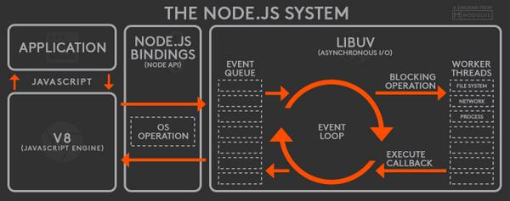
What’s inside Node?
V8
Google's open source JavaScript engine.
Translates your JS code into machine code
V8 is written in C++.
Read more about how V8 works here.
libuv
a multi-platform support library with a focus on asynchronous I/O.
Asynchronous file and file system operations
Thread pool
…
Binding
A wrapper around a library written in one language and expose the library to codes written in another language so that codes written in different languages can communicate.
Other Low-Level Components
such as c-ares, http parser, OpenSSL, zlib, and etc, mostly written in C/C++.
Application
here is your code, modules, and Node.js' built in modules, written in JS
https://stackoverflow.com/questions/36766696/which-is-correct-node-js-architecture
Notes:
https://leezhenghui.github.io/node.js/2018/11/11/demystify-node.js-modularity.html

Slide 26
JS on the Server
An abstract non-blocking IO operations (Async) using thread pool
Part of NodeJs
libuv
OS
Heap Stack
Asynchronous I/O
DB
1. Send request
Network
Reduce()
Filter()
Read files
Add()
Main()
Queue
3. Push only
When Stack
Is Empty
2. When OS is done: Event Notification
Event
Loop
Done1
Done2
Callback

Slide 27
What's the event loop?
The event loop is what allows Node.js to perform non-blocking I/O operations — despite the fact that JavaScript is single-threaded — by offloading operations to the system kernel whenever possible.
— from node.js doc
A loop that picks events from the event queue and pushes their callbacks into the call stack.
Node.js runs using a single thread, at least from a Node.js developer's point of view. Under the hood Node uses many threads through libuv.

Slide 28
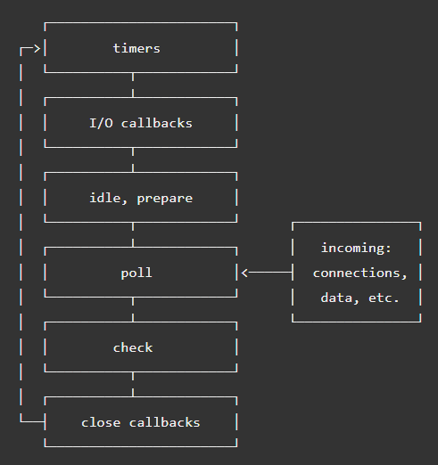
Event Loop
timers: this phase executes callbacks scheduled by setTimeout() and setInterval().
pending callbacks: executes I/O callbacks deferred to the next loop iteration.
idle, prepare: only used internally.
poll: retrieve new I/O events; execute I/O related callbacks (almost all with the exception of close callbacks, the ones scheduled by timers, and setImmediate()); node will block here when appropriate.
check: setImmediate() callbacks are invoked here.
close callbacks: some close callbacks, e.g. socket.on('close', ...).
https://nodejs.org/en/docs/guides/event-loop-timers-and-nexttick/
Notes:
https://blog.logrocket.com/a-complete-guide-to-the-node-js-event-loop/

Slide 29
setTimeout vs setImmediate
setTimeout
schedules a callback to run after a specific time, the functions are registered in the timers phase of the event loop.
setImmediate
schedules a callback to run at check phase of the event loop after IO events' callbacks.

Slide 30
process.nextTick(callback)
process.nextTick() is not part of the event loop, it adds the callback into the nextTick queue. Node processes all the callbacks in the nextTick queue after the current operation completes and before the event loop continues.
Which means it runs before any additional I/O events or timers fire in subsequent ticks of the event loop.
Note: the next-tick-queue is completely drained on each pass of the event loop before additional I/O is processed. As a result, recursively setting nextTick callbacks will block any I/O from happening, just like a while(true) loop.

Slide 31
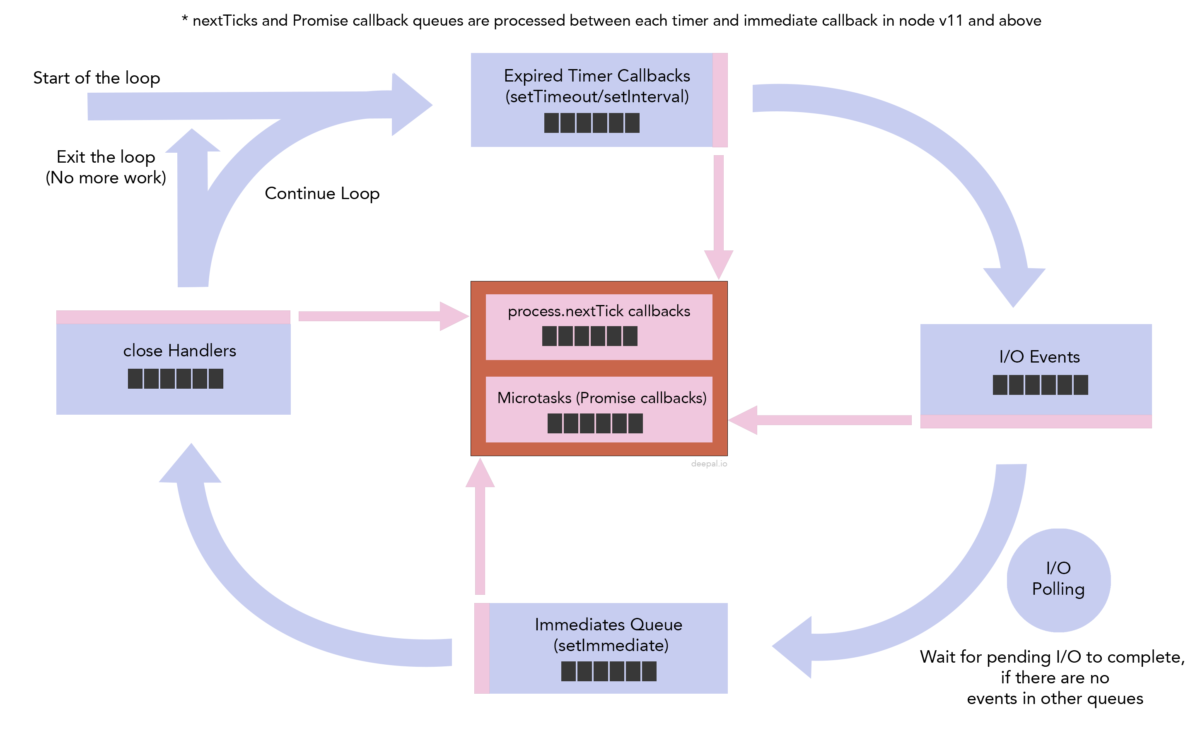
process.nextTick(callback)
NOTE:
Next tick queue is displayed separately from the other four main queues because it is not natively provided by the libuv, but implemented in Node.
https://blog.insiderattack.net/event-loop-and-the-big-picture-nodejs-event-loop-part-1-1cb67a182810

Slide 32
process.nextTick(callback)
function foo() {
console.log('foo');
}
process.nextTick(foo);
console.log('bar');
Notice that bar will be printed in the console before foo, as we have delayed the invocation of foo() till the next tick of the event loop. We can get the same result by using setTimeout() this way:
setTimeout(foo, 0);
console.log('bar');
However, process.nextTick() is not just a simple alias to setTimeout(fn, 0).
What's the difference and why it's more efficient?

Slide 33
setTimeout vs setImmediate vs process.nextTick
setTimeout(() => { console.log('timeout'); }, 0);
setImmediate(() => { console.log('immediate'); });
process.nextTick(()=> console.log('nexttick'));
What's the output of this code and why?

Slide 34
Resources
What is a Full Stack developer?
Wait, Wait… What is a Full-stack Web Developer After All?
The Myth of the Full-stack Developer
Multi-tier Architecture
What is the 3-Tier Architecture?
https://www.journaldev.com/7462/node-js-architecture-single-threaded-event-loop
Nodejs.org
Npmjs.com
Node API Documentation
NPM Documentation
The Node.js Event Loop, Timers, and process.nextTick()

Slide 35
Homework
Write the necessary Node script to make this code work for all arrays:
[1,2,3,4,5,6,7,8].even(); // [2,4,6,8]
[1,2,3,4,5,6,7,8].odd(); // [1,3,5,7]
Test your code in Node.JS CLI

Slide 36
Homework
// Fix the slow function to be asynchronous/non-blocking
function slow(callback){
for(let i=0; i<= 5e8; i++){}
if (Math.random() > 0.5) {
return callback("Error",null)
}
callback(null, {id:12345})
}
function exec(fn){
// Complete the code here to implement chaining with callback
}
exec(slow).done(function(data){ console.log(data); })
.fail(function(err){ console.log("Error: " + err); });

Slide 37
Homework
Explain why do we want sometimes to use setImmediate instead of using setTimeout?
Explain the difference between process.nextTick and setImmediate?
Name 10 global modules/methods available in Node environment.

